Slide 1
Graph-based Grouping Vicky Yuan

Slide 2
outline
Data collection: Provided ONE-WEEK background data.
Feature engineering: mainly focused on transaction amount
possibly add wallet money amount filter(for example, get rid of data which holds money less than $1
3. Model choose: 3 methods 4. Analysis: depends on model choice and training test.

Slide 3
Three models choice
1. Markov Cluster algorithm, MCL is a method for clustering weighted or simple networks.(This is what I’m currently working on)
https://github.com/micans/mcl?tab=readme-ov-file#rcl-fast-multi-resolution-consensus-clustering
It simulates random walks on the graph, where nodes act as states and edges as transition probabilities.
The algorithm alternates between two steps: expansion (inflation) and inflation (expansion)
GraphRAD, a risky account detection system based on local graph clustering algorithms, is proposed, hypothesize that fraud accounts share dense connections within a "fraud community", but have less so with accounts outside of the community
https://www.semanticscholar.org/paper/GraphRAD-%3A-A-Graph-based-Risky-Account-Detection-Ma-Zhang/e1164f6d55d8d12a3cd7b16d202e40f7d7f5d2e8
GraphRAD is a clustering algorithm based on the concept of radius within a graph.
It starts by selecting a random node and expanding a neighborhood around it until a certain radius is reached. All nodes within this radius are considered part of the same cluster.
A collection of community detection research papers.
Similar collections about graph classification, classification/regression tree, fraud detection, and gradient boosting papers with implementations.
https://github.com/benedekrozemberczki/awesome-community-detection

Slide 4
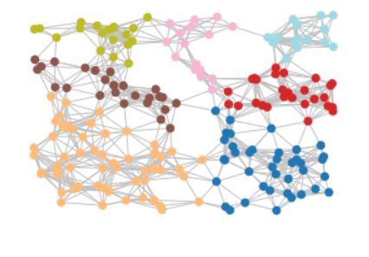
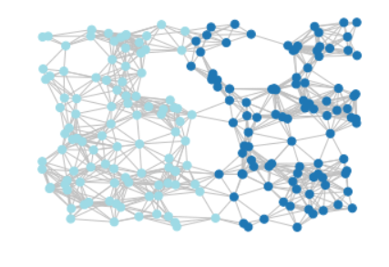
Inflation rate = 2.0
Inflation rate = 1.1

Slide 5
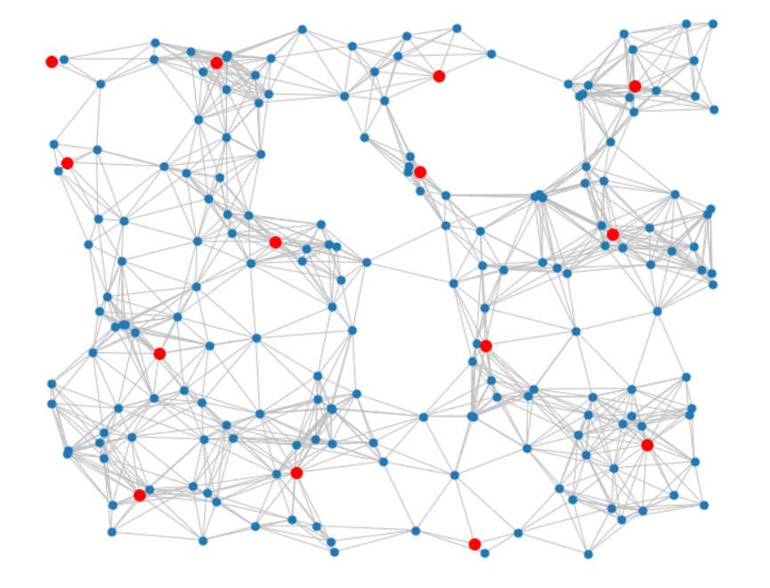
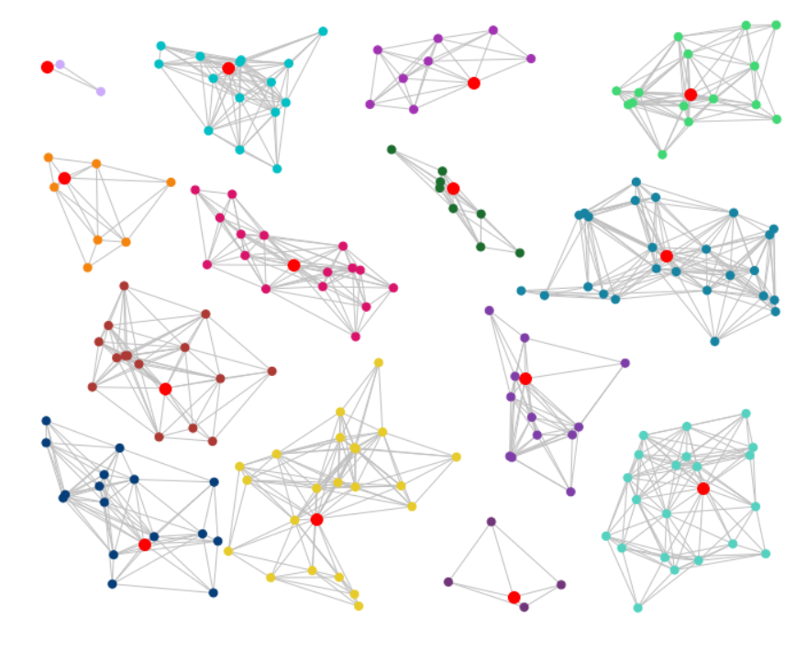
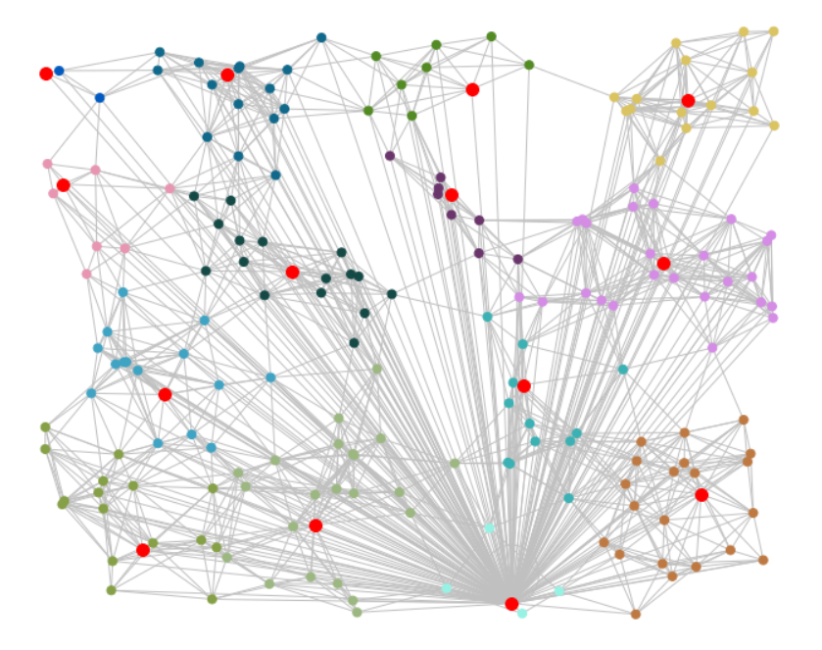
Steps to find the central node in each cluster
based on degree centrality

Slide 6
Comments on the code
Code structure:
Import part and read from Json file
Markov Clustering Part
Degree Centrality Part
Save cluster information to a CSV file
Create a new graph to represent the overview
Draw the overview graph and save if as Jpg file

Slide 7
Comments on the code
Some issues might encounter:
1. If in-degree values(central) are 0 for a clusters, which suggests that there are no edges directed towards the nodes in the cluster.
2. If crashes due to running time or cache, run steps one by one, for example, run till [# Save cluster information to a CSV file] instead of generating the graph.
3. If nodes are gray, which means this node is too
separate to be counted as a cluster.

Slide 8
Thank you
Vicky Yuan

